Slide 1
BCI433- System i Business Computing
Week 1: Intro to System i

Slide 2
Agenda
Introduction
Course Details
Intro to System i
Definitions
Write our first CL Program – Lab 1

Slide 3
Ways to Contact
email: azmat.bhatti@senecaccollege.ca
Home Page: https://ict.senecacollege.ca/course/bci433

Slide 4
Course Details
Course Standards
Lecture notes: Under "Course Information" section in Blackboard
Labs:
Labs are available for download from ZEUS server in IFS.
Path: Root File System / Russ / IBC233
Grades will be posted on Blackboard

Slide 5
Promotion Policy
To obtain a credit in this subject, a student must :
Achieve a grade of 50% or better on the final exam
Achieve a weighted average of 50% or better for the tests and final exam
Achieve a grade of 50% or better on the overall course
Evaluation
CSEmail 1%
Reflection 2%
Tests 30%
Labs/Assignments 37%
Final Examination 30%
Total 100%

Slide 6
How to Get an A in this Course
Attend all lectures and labs.
Take notes – write down everything that’s typed or said in class
Ask question if you don’t understand.
Complete labs on time.

Slide 7
IBM’s product offerings/lines
System z
Mainframes!
System I or AS/400 or iSeries or Power System i
i means integration
IBM’s midrange server line designed to grow with a business
System p
(formerly RS/6000) AIX and Linux!!!
IBM’s RISC/UNIX-based server and workstation line designed to accommodate small to medium size businesses
System x
PCs!!

Slide 8
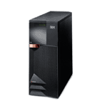
System i
Developed by IBM to support medium to large scales business
i means iNTEGRATION!
A server designed for the on demand challenges of Web and e-business, as well as core On-line Transaction Processing (OLTP) workloads, with support for multiple operating and application environments.

Slide 9
The History of System i

Slide 10
System 3
1969 - 1985
System 32
1975 - 1984
System 34
1977 - 1985
1983 - 1994
System 36
System 38
1980 - 1994
AS/400
1988 - present
iSeries
2000 - present
System i
2006 - 2007
Power Systems
2008

Slide 11
Power Systems
In April 2008, IBM officially merged System i and System p under the same name – Power Systems with identical hardware and a choice of operating systems.
Being as System i, Power Systems run IBM i.
Being as System p, Power Systems run AIX or Linux.
BCI433 covers mainly the System i part of IBM Power Systems, so we mix the usage of System i and Power Systems.

Slide 12
Operating Systems
The operating systems for IBM’s midrange server line:
IBM i – runs on Power Systems or System i.
i5/OS (OS/400 V5R3)– runs on iServers (i5, i Series).
OS/400 – runs on AS/400.
CPF – runs on System 36 and 38.
……
IBM i, i5/OS and OS/400 are basically the same.

Slide 13
Who Uses System i ?
98% of Fortune 100 companies use iSeries and System i :
Microsoft
McDonald's Canada
Canadian Tire (head office and one in every store)
Kraft Foods
Loblaws
Holt Renfrew
Coca Cola
more…

Slide 14
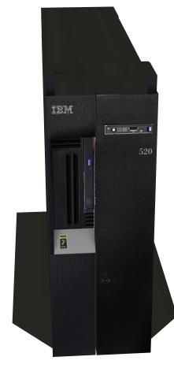
Power System in Seneca
Server name: ZEUS
Installed: in January, 2009.
Model: IBM Power 520 Express
URL: zeus.senecac.on.ca

Slide 15
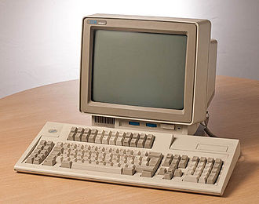
Let’s sign on!

Slide 16
Connectivity Tools
Rational Developer for Power Systems (RDp)
The Eclipse-based Rational IDE
Formerly RDI
Client Access
Production Environment
MOCHAsoft http://www.mochasoft.dk
Production Environment
Download from ITS site

Slide 17
Definitions

Slide 18
User Profiles
Each Userid has a User Profile which describes the user and their authorities
User Profile Contains information such as
Current Library,
default output queue,
password,
class of user

Slide 19
“Job”
A “job” is any and every piece of work on the AS/400.
There are two types of jobs:
Interactive jobs
Batch jobs

Slide 20
“Interactive Jobs”
A job
begins when a user signs on to the system and
ends when they sign off.
It is a job with interaction between the user and the iSeries, similar to a conversation ( a polite conversation!).
Interactive jobs run in subsystem QINTER

Slide 21
“Batch Jobs”
A job that runs in the background.
They are generally jobs that
use a lot of resources and
are lower priority than interactive jobs.
Batch jobs Usually started by interactive jobs
e.g. a program compile, backup, report
Batch jobs run in subsystem QBATCH

Slide 22
Work With Active Jobs
Command is WRKACTJOB
Shows you
all the jobs that are currently running and
their status.

Slide 23
Queues
A queue is a line-up! A place where things wait.
Examples of iSeries queues:3 different type of queues
Job queues: where batch jobs wait
Message queues: where messages wait
Output queues: where spool files wait to print

Slide 24
“Objects”
Anything on the iSeries that has a name and takes up space in storage”
On iSeries, everything is an object
on Unix/Windows, everything is a file
On iSeries objects have types
on Windows, files have extensions (.txt, .doc, .xls, .ppt)
Common object types include:
libraries,
files,
job queues,
Programs,

Slide 25
“Libraries”
Library: an object whose purpose is to ‘store’ and index other objects.
ie. objects are ‘stored’ in libraries.
Exactly like a directory in Unix/Windows
However you do not have libraries within libraries on the iSeries.
Example: Cindy stores all her objects in library LAURIN

Slide 26
Files and Source Files
Files are objects that store data
i.e. customer file: customer #, address, billing info etc. for each customer
Source file - special files that stores a programmer’s source code
e.g. Cindy stores all her source code in a source file in library LAURIN

Slide 27
File Members
A source file may have many ‘members’
one member contains the source code for 1 program
PDM (Programming Development Manager) and Websphere give easy access to a programmer’s stuff (libs, files, and mbrs)

Slide 28
About Your Course Library
Your ‘Course Library’ is the library which has the same name as your Userid.
What Objects Do You Have (in your course library)?
An Output Queue which has the same name as your userid.
All objects which you create will be stored in your course library except for assignments.
Assignments will have separate libraries.
WRKOBJOWN shows you all the objects you ‘own’.

Slide 29
PDM commands
PDM = Program Development Manager
PDM commands | To work with
WRKLIBPDM | libraries
WRKOBJPDM | objects
WRKMBRPDM | members

Slide 30
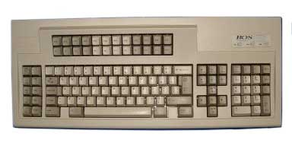
Terminal Keyboard Mapping
System i (iSeries) Terminal Keyboard Mapping
24 Function keys

Slide 31
Commonly Used Function Keys
Function Key | Function
F1 | Help
F2 | Extended Help
F3 | Exit
F4 | Prompt
F5 | Refresh Screen
F9 | Retrieve Previous Command
F12 | Cancel
F23 (Shift+F11) | More options
F24 (Shift+F12) | More function keys

Slide 32
Suggested Actions/Homework
Memorize the basic concepts, definitions in the lecture.
Install Client Access and Rational Developer for Power Systems (DDp) at home.
Reading materials:
Week-1 reading
IBC233 FAQ https://ict.senecacollege.ca/~wei.song/bci433/references/_bci433_FAQ+other.pdf

Slide 33
Lab 1

Slide 34
Thank You!

